Slide 1
ACTIVITY 1: Match the Cause in A with their effects in B. Choose the letters only.
1. Dodong decided to marry Teang
at the age of 17 despite his father’s
advice.
He struggled to provide for his wife and children and realized that marriage was more difficult than he had imagined.
2. Teang became pregnant soon
after their marriage.
B. Dodong realized history was repeating
itself and understood his father’s feelings, but
he allowed Blas to make his own decision.
3. Dodong had to support his growing
family while still very young..
C. They faced the responsibilities and
hardships of married life much earlier
than they expected.
4. Teang married Dodong instead of
Lucio, whom she once admired.
D. Years later, she occasionally wondered
what her life might have been like had she
chosen differently, though she accepted her
responsibilities.
5. Blas, Dodong's eldest son, asked
permission to marry young, just as
Dodong once did.
E. She experienced physical exhaustion and
found it difficult to adjust to the demands of
motherhood.

Slide 2
LEARNING OBJECTIVES:
1. Define conflict;
2. Compare and contrast the types of
conflict through situational examples; and
3. Identify conflicts experienced in real life
and share non-violent means of
resolving them.

Slide 3
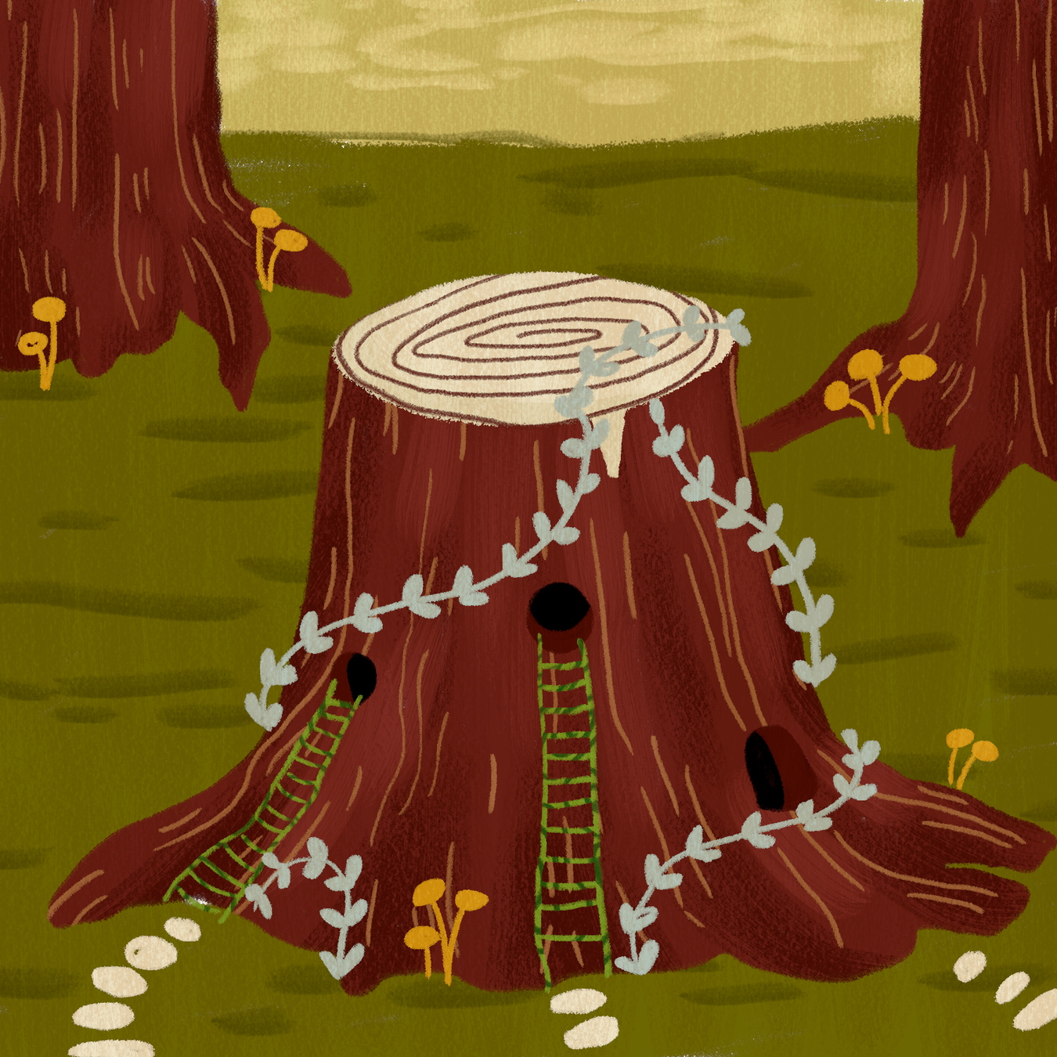
What is Conflict?
It is a problem, struggle, or challenge that a character faces in a story.
It’s what makes the story interesting and keeps readers wanting to know what will happen next.
Without conflict, there would be no reason for the characters to take action or change.

Slide 4
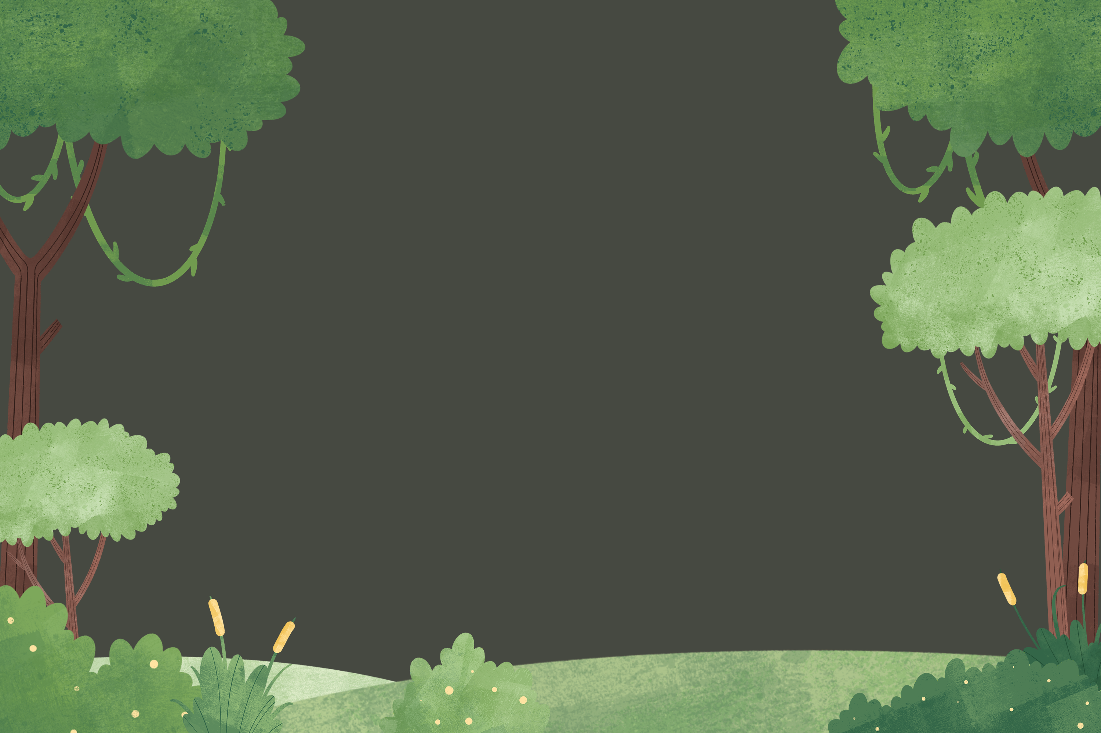
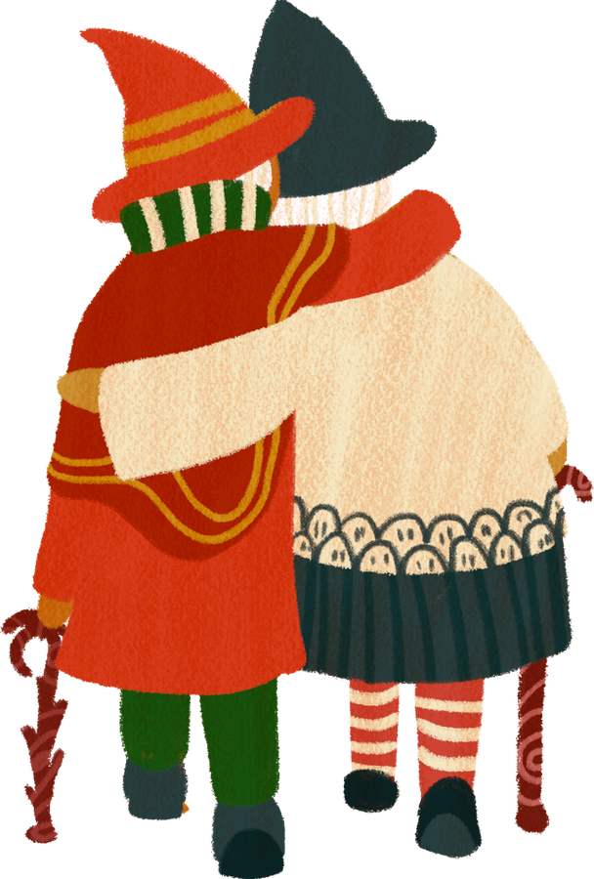

TYPES OF
conflict

Slide 5


TYPES OF CONFLICT
Internal
External
man vs. self
man vs. man
man vs. nature
man vs. society

Slide 6
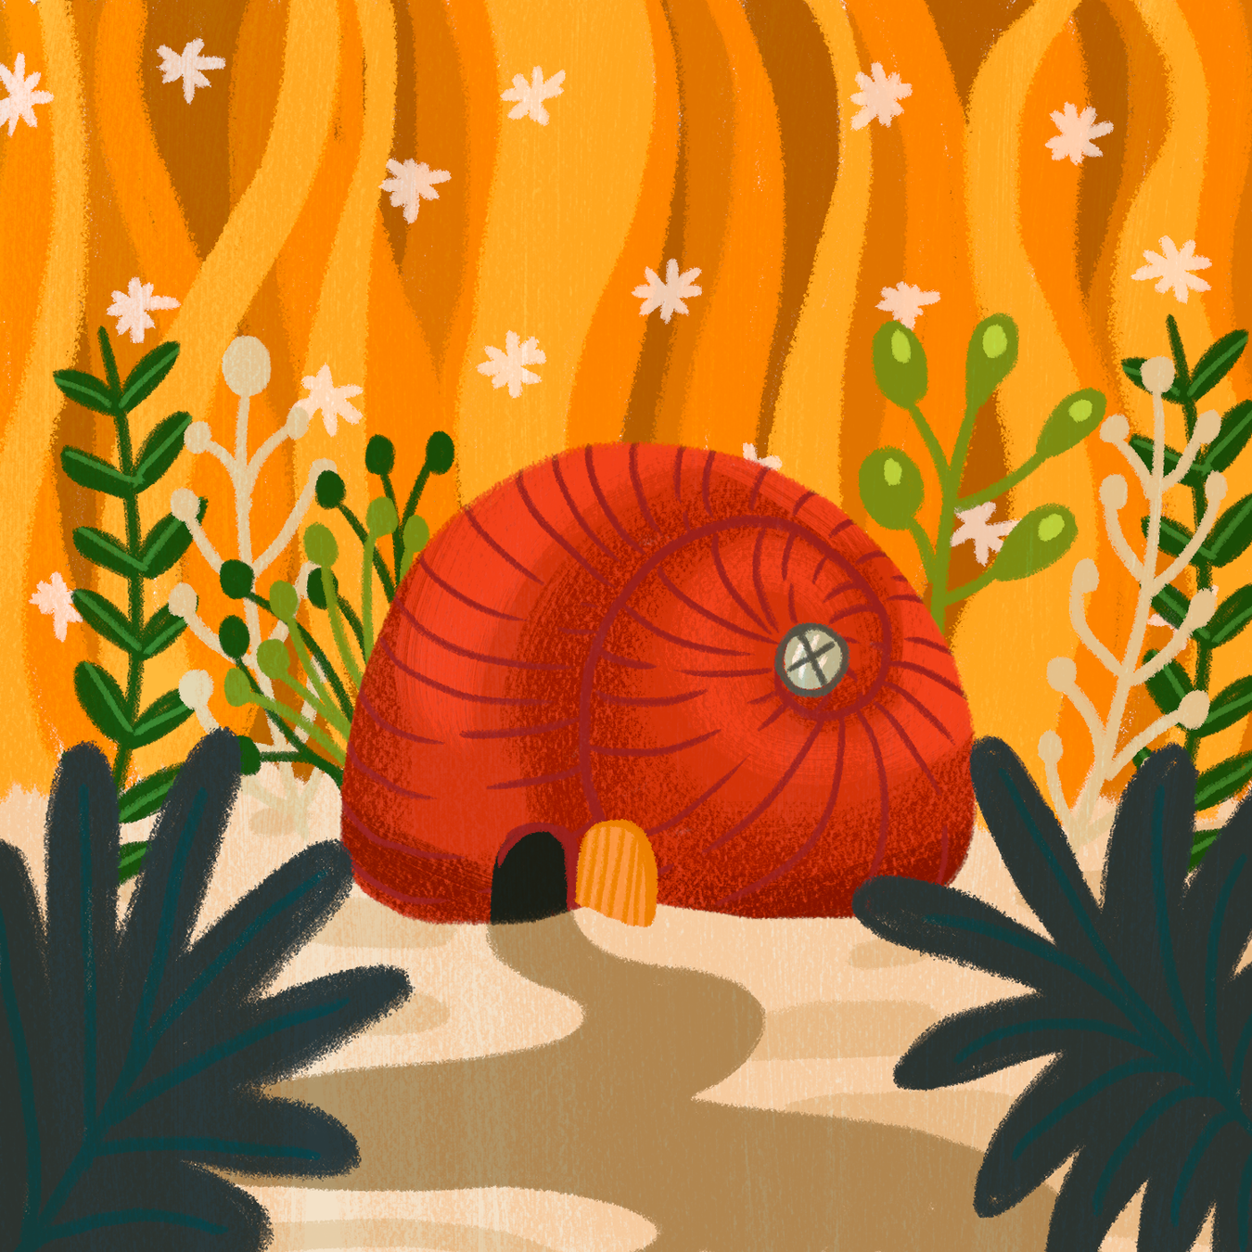
Internal Conflict
A conflict when the protagonist faces problems within themselves; this could be because of their fears, lack of confidence, desires, or other issues in their mind.

Slide 7
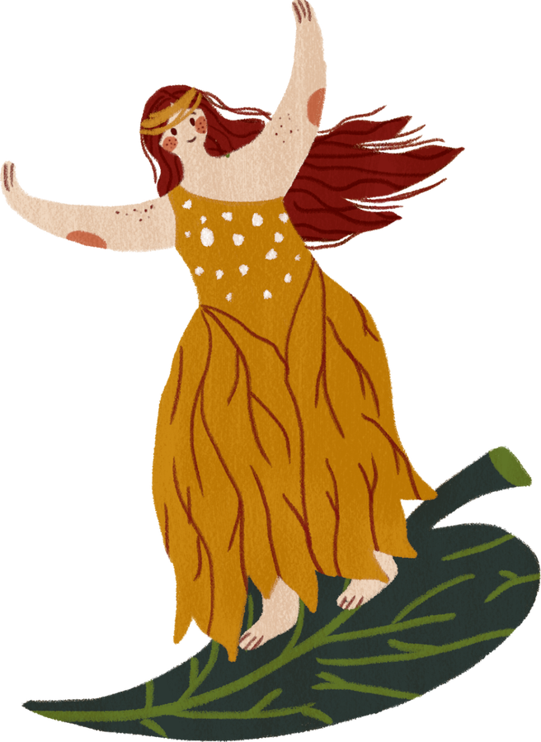
man vs. self
A struggle within a character’s mind—often involving emotions, choices, doubts, or beliefs.
Example:
A character deciding whether to follow their dreams or fulfill family expectations.

Slide 8
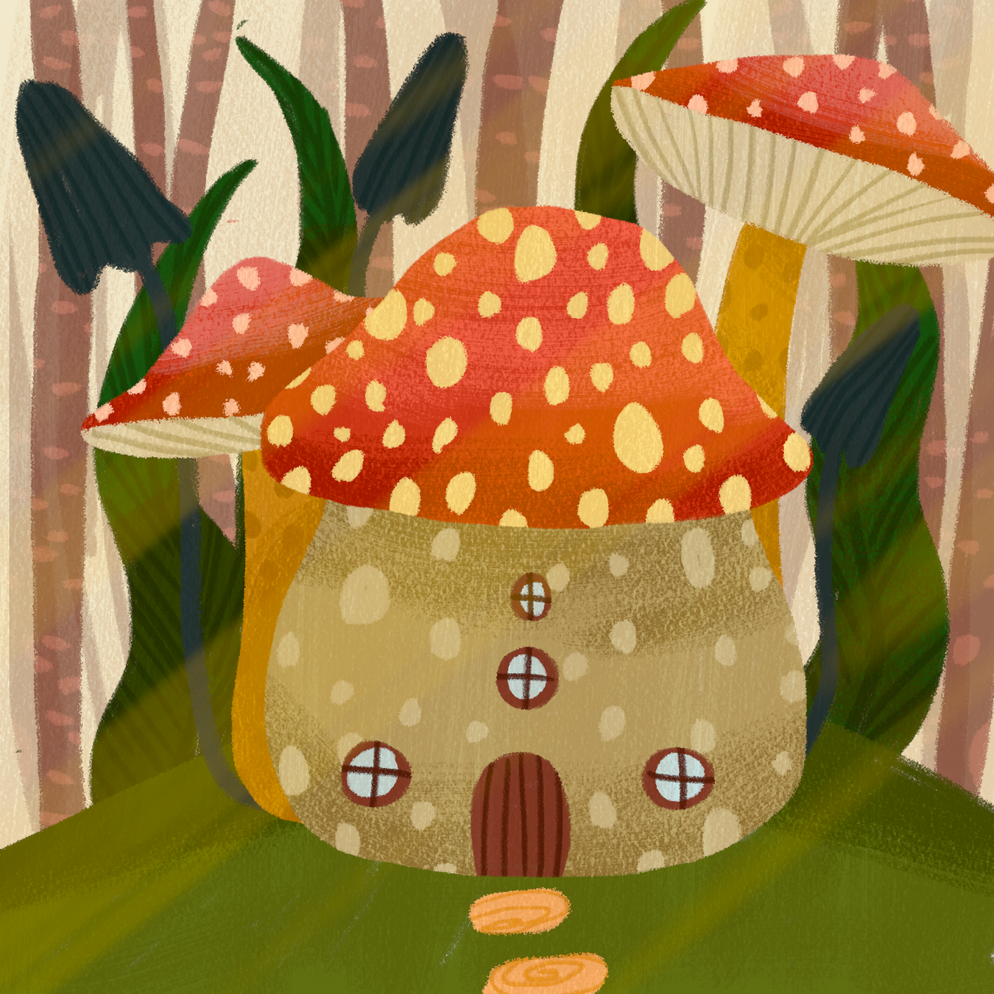
External Conflict
A conflict that occurs between characters and other external forces such as technology, nature, society and others.

Slide 9
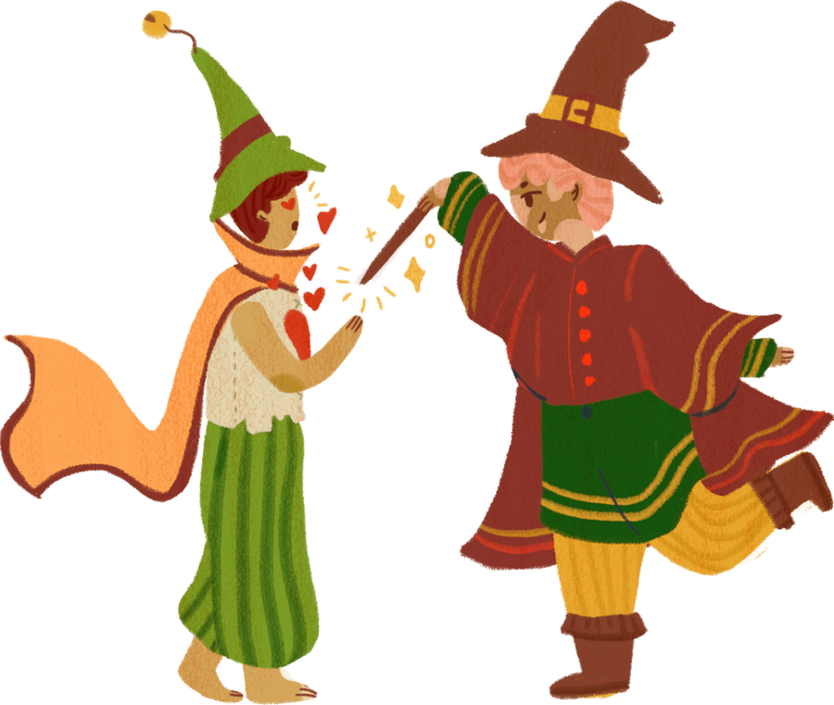
man vs. man
Two characters want different things, and their goals or beliefs clash. This could be a physical fight, a verbal argument, or even silent rivalry.
Example:
A detective races against a criminal mastermind to solve a case.

Slide 10
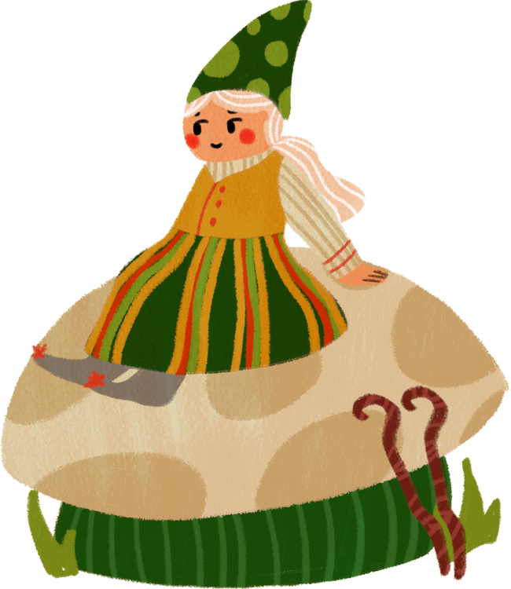

man vs. nature
The character struggles against the environment or natural forces.
Example:
A hiker gets lost in the forest and must find a way back before dark.

Slide 11


man vs. society
The character struggles with unfair rules, traditions, or expectations.
Example:
A teenager challenges the tradition that girls can’t play on the local basketball team.

Slide 12

ACT. 2 - Let’s Try!
1.Sarah is torn between following her family's tradition of becoming a doctor or pursuing her passion for art. She struggles with disappointing her parents while staying true to herself.

Slide 13
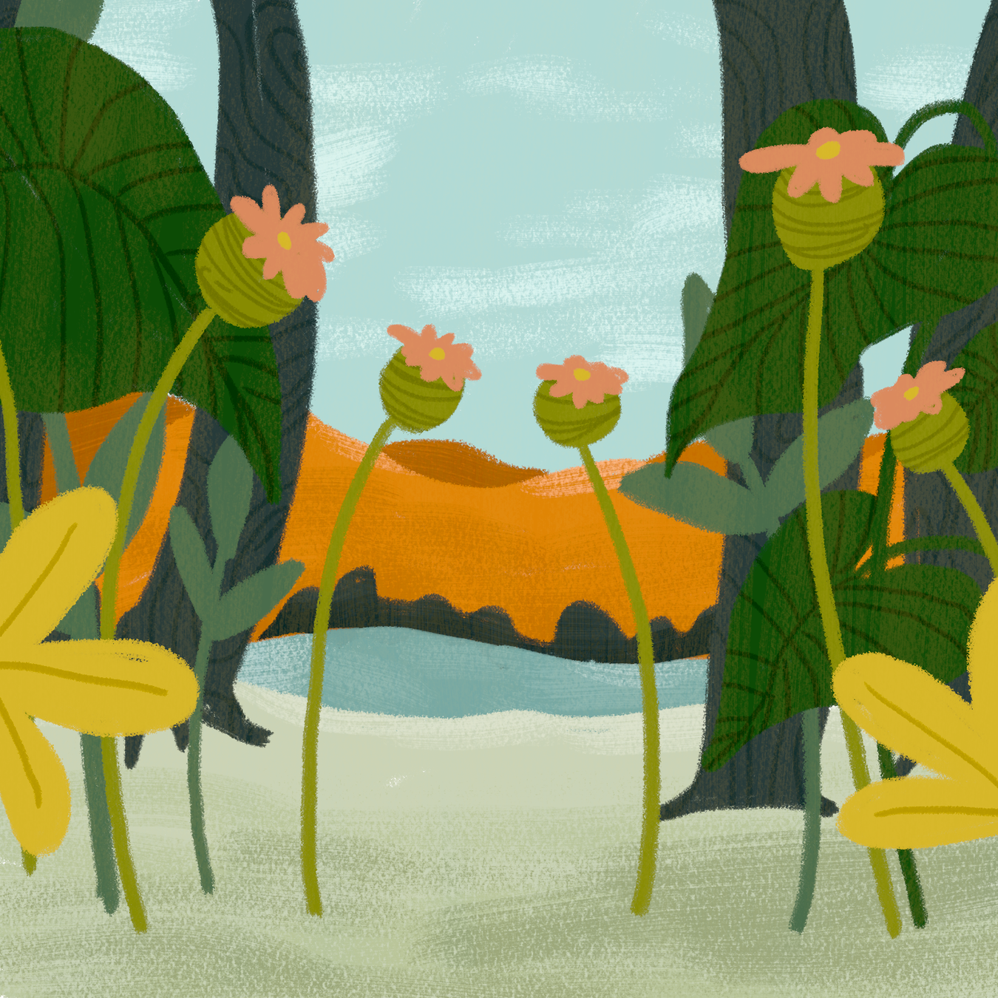
Let’s Try!
2. A group of hikers gets caught in a sudden blizzard while climbing Mount Everest. They must find shelter and survive the harsh weather conditions.

Slide 14
Let’s Try!
3. Detective Johnson is determined to catch the notorious criminal who has been terrorizing the city. The criminal always seems to be one step ahead, leading to an intense cat-and-mouse game.

Slide 15
Let’s Try!
4. Two rival business owners compete for the same customers in a small town. They constantly try to outdo each other with better prices and services.

Slide 16
Let’s Try!
5. A farmer's crops are destroyed by a severe drought. She must find ways to save her farm and provide for her family despite the harsh weather conditions.

Slide 17
ACT. 2 - Suggest non-violent ways to solve the following issues.
Group members disagree on who
should be the leader.
2. Two friends stop talking because one
spread a rumor.

Slide 18
ACT. 2 - Suggest non-violent ways to solve the following issues.
3. A student wants to join the school singing contest
but is afraid of performing in front of others.
4. A student wants to spend all day playing online
games instead of doing homework.

Slide 19
ACT. 2 - Suggest non-violent ways to solve the following issues.
5. A family experiences a power outage
during a typhoon.
6. A student gets caught in extreme heat while
walking home.

Slide 20
ACT. 2 - Suggest non-violent ways to solve the following issues.
7. A student reports classmates who are
vandalizing school property, but others call
him a "snitch" and stop talking to him.
8. A new student from another province
speaks with a different accent and is often
excluded from group activities.

Slide 21

THANK YOU FOR LISTENING!

